Slide 1

Testing Participation
Increasing SAT participation on a national scale.

Slide 2

Objectives
Identify participation trends across the nation for SAT.
Compare with similar data from ACT
Locate potential areas of improvement
Find insights into testing behavior
Develop strategies for increased participation

Slide 3
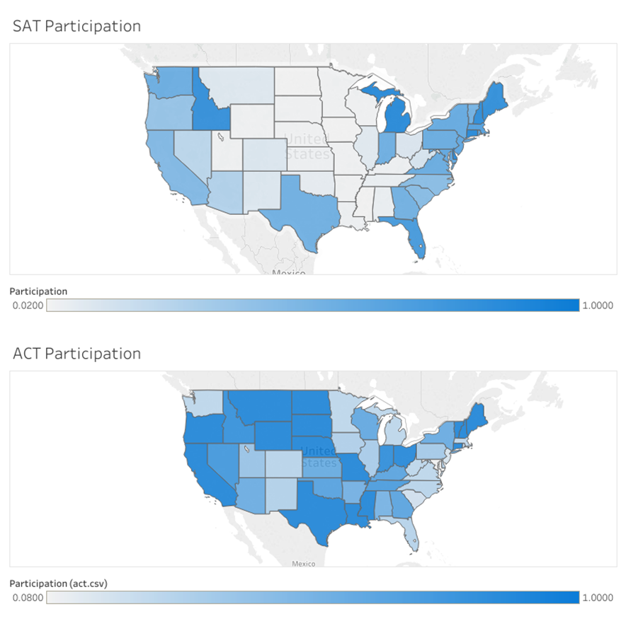
Identify Participants
The majority of SAT participation nearly mirrors states that lack ACT participation.
Correlation Coefficient of -.84 signifying a substantial negative correlation.
The Majority of the east coast continues to use the SAT as their choice for pre-collegiate standardize testing.
p value of .0002817, enough to reject null hypothesis

Slide 4
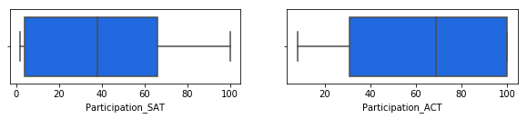
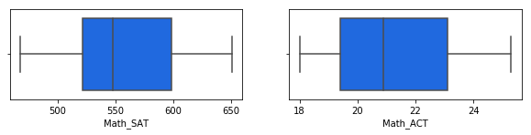
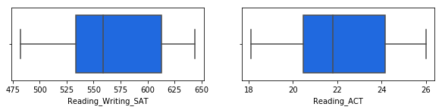
Similar Yet Different
Similar distribution of scores between the two tests.
Only notable difference is participation
Why?

Slide 5
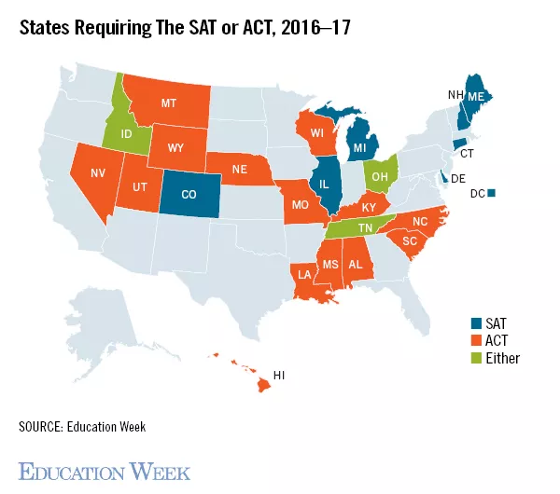
Mapping Differences

Slide 6
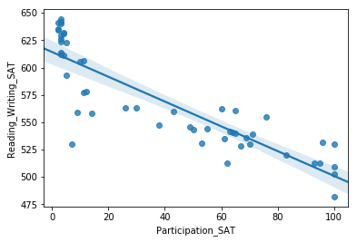
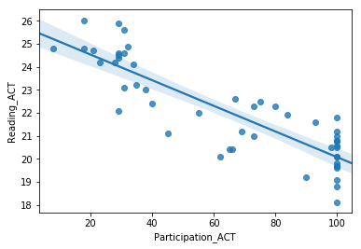
Lower participation but higher scores…
P value low enough to reject null
P value low enough to reject null
Corrrcoef: -.8743
Corrrcoef: -.8665

Slide 7
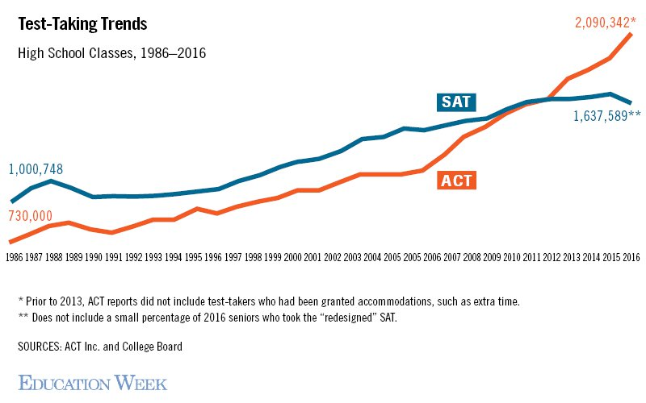
Suggestions
Push legislation for SAT implementation as required during the school year.
Make test more accessible to students and resources further available.
ACT attracts more students by being free and being more applicable to regular curriculum

Slide 8
Source info:
https://www.wrpawprint.com/wp-content/uploads/2016/02/800px-college_board_logo.png
https://blog.prepscholar.com/average-sat-scores-by-state-most-recent
https://www.edweek.org/ew/articles/2017/05/24/in-race-for-test-takers-act-outscores-sat--for.html
https://www.georgiafamily.com/wp-content/uploads/2017/04/STOCK-School-taking-test-3x4-COMP-770x578.jpg

